Slide 1

INFOSYS SPRINGBOARD VIRTUAL INTERNSHIP 7.0 FINAL PRESENTATION
AI-Based Knowledge Retrieval Platform with Query Resolution System
An Intelligent RAG-Based Multi-Agent Platform for Context-Aware Knowledge Retrieval
[ RAG • Multi-Agent AI • LangGraph • FastAPI • React • ChromaDB • PostgreSQL ]

Slide 2








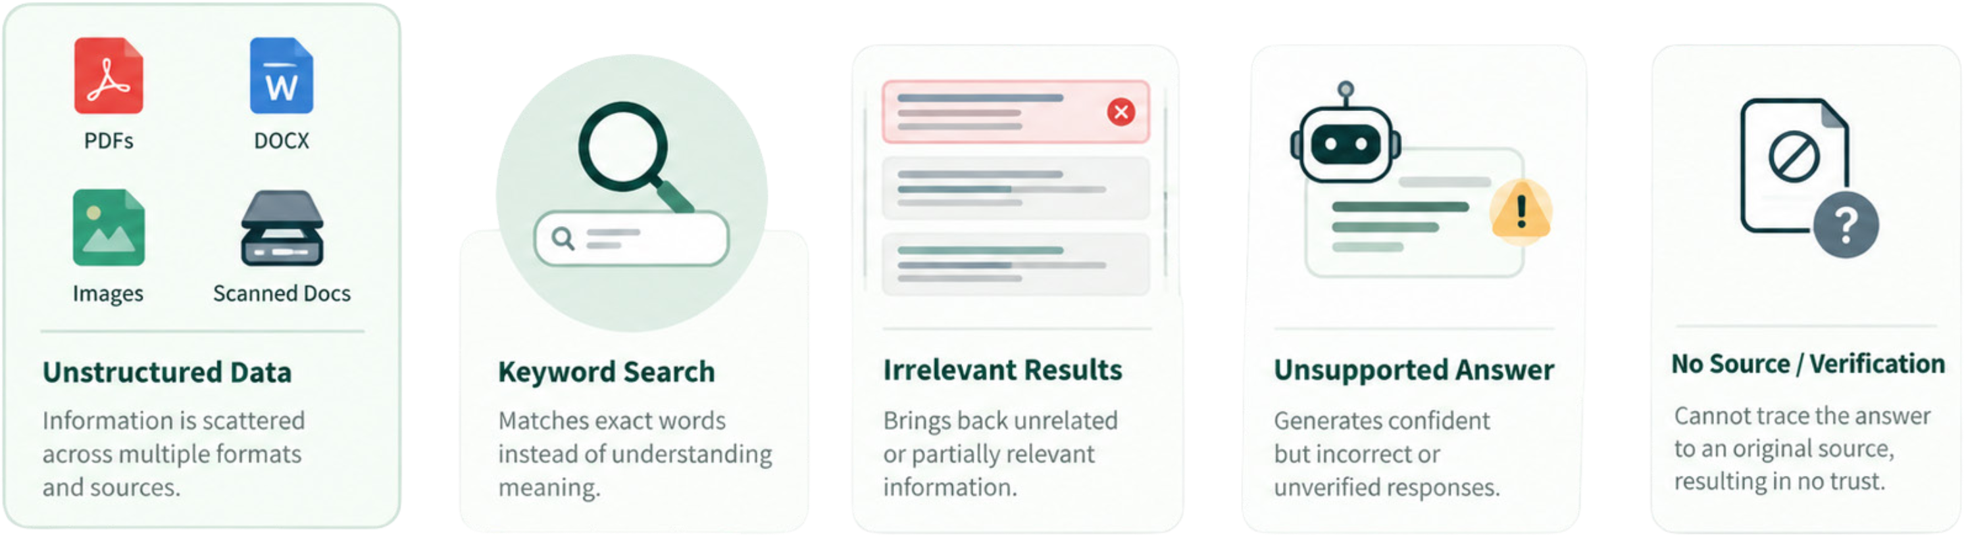
The Problem: Unstructured Knowledge at Scale
Data Overload
Semantic Blindness
Organizations hold extensive data in various formats, lacking a unified query method.
Keyword search fails to understand meaning. Users searching for concepts get irrelevant or zero results.
Hallucinated Answers
No Verifiability
Generic LLMs generate confident but unsupported answers — with no grounding in the organization's actual documents.
Users cannot trace where an answer came from, making
AI-generated responses untrustworthy in high-stakes contexts.

Slide 3



Why This Matters
The gap between raw organizational knowledge and actionable answers is widening. Existing tools fall short in three critical ways:
Solution needed: A system that understands queries, retrieves knowledge, reasons over it, and generates grounded answers with evidence.
1
Ambiguous Queries
Vague or incomplete questions require manual clarification loops, slowing down knowledge workers.
2
Lost Context
Follow-up questions lose conversation history — every query is treated as if it were the first.
3
Inaccessible Documents
Scanned and image-based documents remain invisible to standard text pipelines without OCR integration.

Slide 4
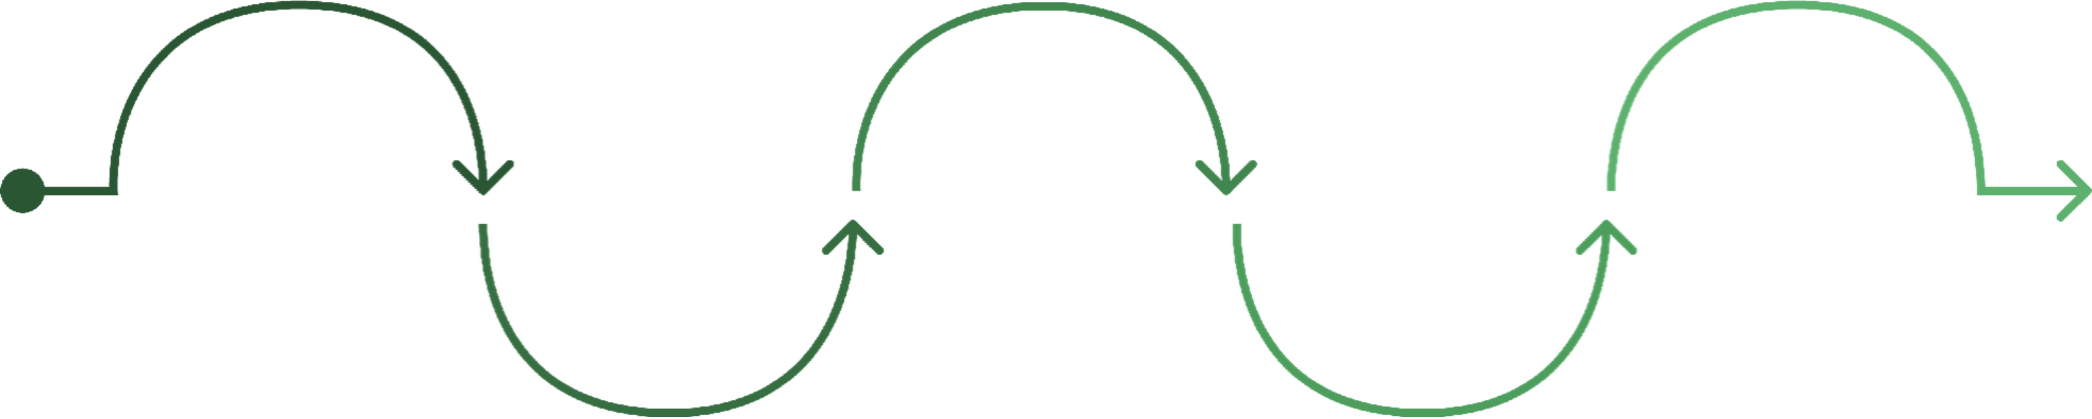
Proposed Solution: RAG + Multi-Agent Architecture
Build
Retrieve
Ingest
Semantic chunking and vector embeddings
Understand
Generate
Semantic + exact search with ranking
PDF, DOCX, TXT, CSV, JPG, PNG with OCR
Intent, entities, and complexity analysis
Grounded responses with citations and scores
A unified pipeline that transforms raw documents into verifiable, context-aware answers — powered by multi-agent reasoning at every stage.

Slide 5
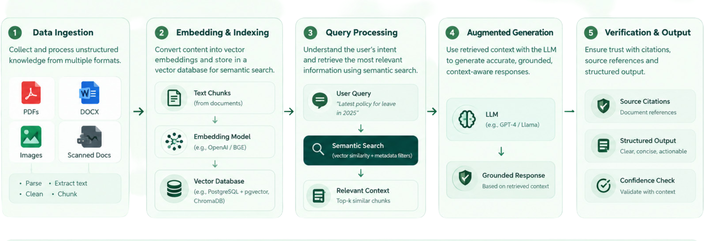
System Architecture Overview
Multi-layered pipeline: React frontend → FastAPI backend → LangGraph agents → PostgreSQL + ChromaDB storage.

Slide 6
Knowledge Ingestion & RAG Pipeline
During querying, relevant chunks are retrieved and passed to the LLM
— grounding answers in your documents, not just pretraining data.
01
02
Upload & Validate
Extract & OCR
Documents are received, validated for format, and queued for processing.
PyMuPDF handles native text; PaddleOCR processes scanned images and handwritten content.
03
04
Clean & Chunk
Embed & Store
Text is normalized, deduplicated, and split into semantically coherent chunks.
all-MiniLM-L6-v2 generates embeddings stored in ChromaDB for retrieval at query time.

Slide 7





Multi-Agent Query Resolution
Query Understanding Agent
Retrieval Agent
Clarification Agent
Detects intent, extracts entities, and flags ambiguity before retrieval begins.
Runs semantic + exact search with hybrid ranking and filters low-relevance results.
Handles incomplete queries — e.g., "What is its ranking?" triggers a context request.
Response Generation Agent
Memory Agent
Produces grounded answers with source citations and confidence scores.
Maintains conversation context so follow-up questions remain coherent across turns.

Slide 8

Technology Stack & Outcomes
Full Stack
Key Outcomes
Domain-agnostic RAG — works across any document type or industry
Layer | Technologies
Frontend | React 19, Vite, JavaScript
Backend | Python, FastAPI, LangChain, LangGraph, Groq LLM
Processing | PyMuPDF, PaddleOCR, Sentence Transformers
Databases | ChromaDB (vectors), PostgreSQL (metadata)
Grounded responses — every answer backed by retrieved evidence
Voice-enabled interaction — accessible, natural query experience
Query analytics — continuous insight into system performance
Transparent retrieval — full evidence chain visible to users

Slide 9
Thank You
Questions and discussion

